Slide 1
数据隐私方法伦理和实践 Methodology, Ethics and Practice of Data Privacy
2. 隐私定义
Privacy Definition
张兰
中国科学技术大学 计算机学院
2021春季

Slide 2
0. Dimensions of Private Data Usage
Who, What, When, Where, How, Why, How much

Slide 3



Who involved
Data Owners
Semi-Honest
Malicious
Service Providers
Other Data Owners
Attackers
…

Slide 4

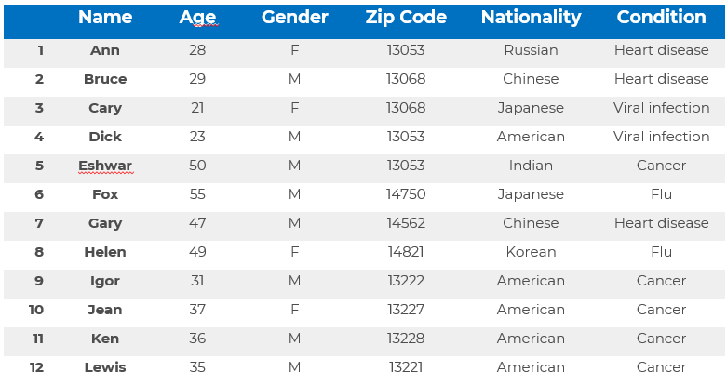
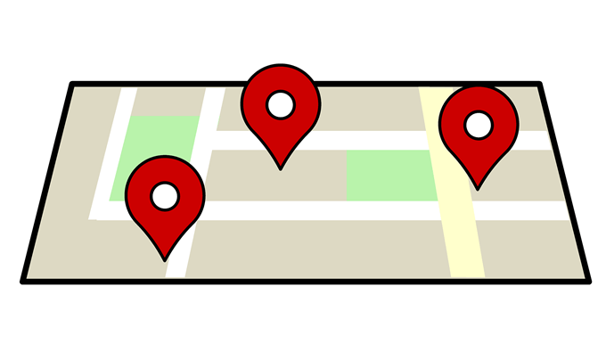
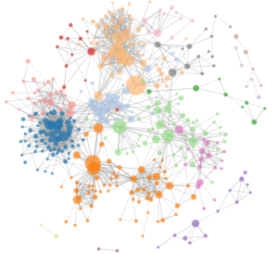
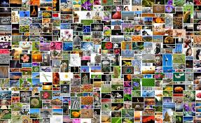


What to protect

Slide 5
What to protect
Microdata: represents a set of records containing information on an individual unit such as a person, a firm, an institution
Macrodata: represents computed/derived statistics
Models and patterns: from machine learning and data mining

Slide 6
What to protect
Uninformative principle (Dalenius1977)
Access to the published data does not reveal anything extra about any target victim, even with the presence of attacker’s background knowledge obtained from other sources
Similar to semantic security of encryption
Knowledge of the ciphertext (and length) of some unknown message does not reveal any additional information on the message.

Slide 7
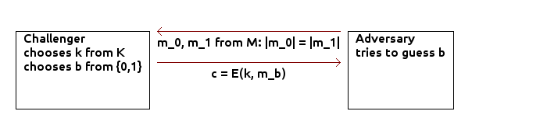
What to protect
Uninformative principle (Dalenius1977)
Access to the published data does not reveal anything extra about any target victim, even with the presence of attacker’s background knowledge obtained from other sources
Similar to semantic security of encryption
Knowledge of the ciphertext (and length) of some unknown message does not reveal any additional information on the message.

Slide 8
What to protect
Membership disclosure: Attacker can tell that a given person is in the dataset
Identity disclosure: Attacker can tell which record corresponds to a given person
Sensitive attribute disclosure: Attacker can tell that a given person or record has a certain sensitive attribute

Slide 9
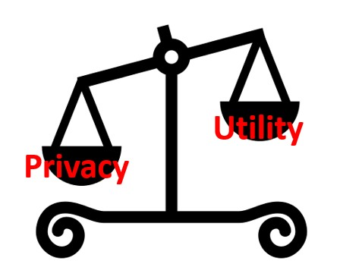
Why so difficult
Privacy (disclosure risk)-the risk that a given form of disclosure will arise if the data is released
Utility (information loss)-the information which exist in the initial data but not in released data due to disclosure control methods

Slide 10
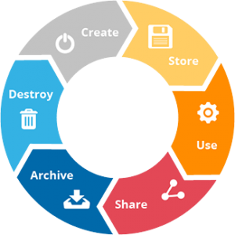
When to protect
Collection
Outsource
Access Control
Search
Forgetting
Proof
Statistics
Compute Funcs
Mining Learning
Restrict Usage
Proof of Storage
Publish

Slide 11
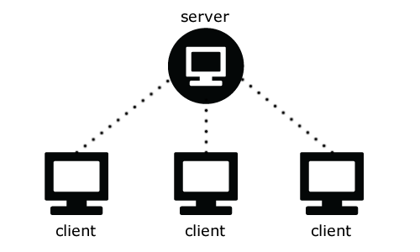
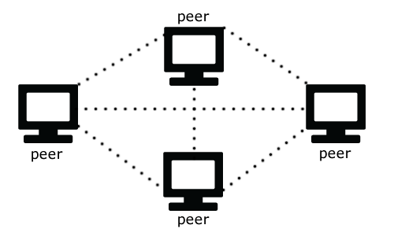
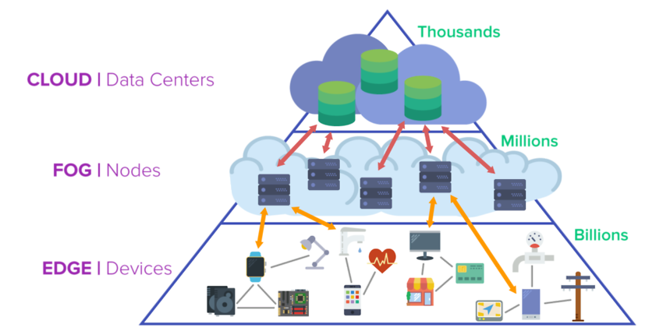
Where to operate
https://www.imagimob.com/blog/edge-computing-needs-edge-ai

Slide 12

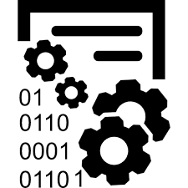
How to protect
Access control: protecting information from being accessed by unauthorized users.
Inference control (disclosure control): protecting private data from being inferred from sanitized data or models by users
Access Control
Inference Control

Slide 13
Inference Control Methods
不给/部分不给
Suppress
Break linkage
Monitor the queries: query restriction/auditing

Slide 14
Suppress
De-identification
 | Name | Age | Gender | Zip Code | Nationality | Condition
1 | Ann | 28 | F | 13053 | Korean | Heart disease
2 | Bruce | 29 | M | 13068 | Chinese | Heart disease
3 | Cary | 21 | F | 13068 | Japanese | Viral infection
4 | Dick | 23 | M | 13053 | American | Viral infection
5 | Eshwar | 50 | M | 13053 | Indian | Cancer
6 | Fox | 55 | M | 14750 | Japanese | Flu
7 | Gary | 47 | M | 14562 | Chinese | Heart disease
8 | Helen | 49 | F | 14821 | Korean | Flu
9 | Igor | 31 | M | 13222 | American | Cancer
10 | Jean | 37 | F | 13227 | American | Cancer
11 | Ken | 36 | M | 13228 | American | Cancer
12 | Lewis | 35 | M | 13221 | American | Cancer

Slide 15
Break Linkage
Bucketization
Age | Gender | Zip Code | Nationality | BID
28 | F | 13053 | Korean | 1
29 | M | 13068 | Chinese | 1
47 | M | 14562 | Chinese | 1
…
31 | M | 13222 | American | 3
37 | F | 13227 | American | 3
36 | M | 13228 | American | 3
35 | M | 13221 | American | 3
BID | Condition
1 | Heart disease
1 | Heart disease
1 | Viral infection
…
3 | Cancer
3 | Cancer
3 | Cancer
3 | Cancer

Slide 16
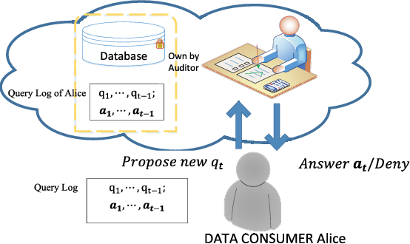
Monitor the queries: query auditing

Slide 17
Inference Control Methods
不给/部分不给
Suppress
Break linkage
Monitor the queries: query restriction/auditing
给加密的
Secure Multiparty Computing

Slide 18
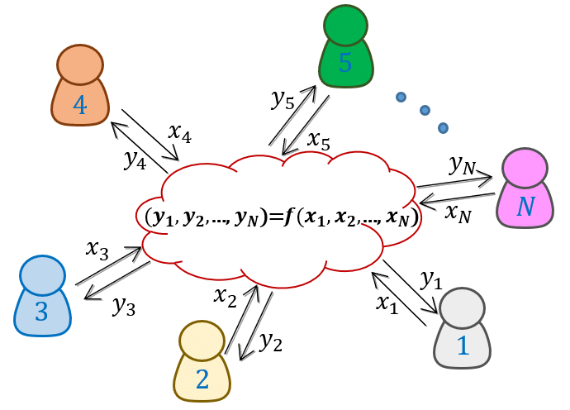
Secure Multi-party Computation

Slide 19
Inference Control Methods
不给/部分不给
Suppress
Break linkage
Monitor the queries: query restriction/auditing
给加密的
Secure Multiparty Computing
给不精准的
Change granularity: generalize/aggregate
Change accuracy: swapping/add noise (DP)
Extract features: federated learning

Slide 20
Change granularity: generalize/aggregate
 | Name | Age | Gender | Zip Code | Nationality | Condition
1 | Ann | 20-29 | Any | 130** | Asian | Heart disease
2 | Bruce | 20-29 | Any | 130** | Asian | Heart disease
3 | Cary | 20-29 | Any | 130** | Asian | Viral infection
4 | Dick | 20-29 | Any | 130** | Asian | Viral infection
5 | Eshwar | 40-59 | Any | 130** | Asian | Cancer
6 | Fox | 40-59 | Any | 14*** | Asian | Flu
7 | Gary | 40-59 | Any | 14*** | Asian | Heart disease
8 | Helen | 40-59 | Any | 14*** | Asian | Flu
9 | Igor | 30-39 | Any | 1322* | American | Cancer
10 | Jean | 30-39 | Any | 1322* | American | Cancer
11 | Ken | 30-39 | Any | 1322* | American | Cancer
12 | Lewis | 30-39 | Any | 1322* | American | Cancer

Slide 21
Change accuracy
Swapping
 | Name | Age | Gender | Zip Code | Nationality | Condition
1 | Ann | 28 | F | 13053 | Korean | Heart disease
2 | Bruce | 29 | M | 13068 | Chinese | Heart disease
3 | Cary | 21 | F | 13068 | Japanese | Viral infection
4 | Dick | 23 | M | 13053 | American | Viral infection
5 | Eshwar | 50 | M | 13053 | Indian | Cancer
6 | Fox | 55 | M | 14750 | Japanese | Flu
7 | Gary | 47 | M | 14562 | Chinese | Heart disease
8 | Helen | 49 | F | 14821 | Korean | Flu
9 | Igor | 31 | M | 13222 | American | Cancer
10 | Jean | 37 | F | 13227 | American | Cancer
11 | Ken | 36 | M | 13228 | American | Cancer
12 | Lewis | 35 | M | 13221 | American | Cancer

Slide 22

Change accuracy
Add (random) noise
https://www.theguardian.com/world/2020/feb/01/privacy-campaigners-dazzle-camouflage-met-police-surveillance

Slide 23
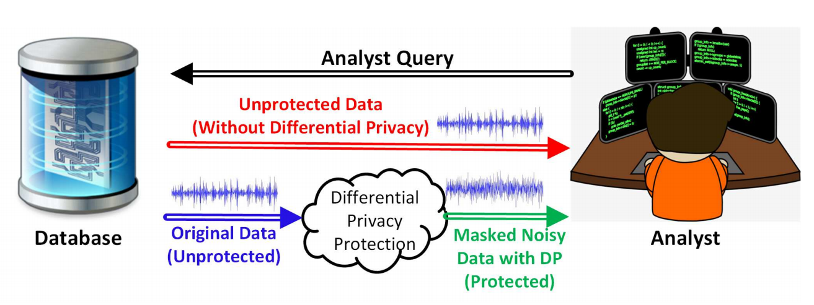
Change accuracy
Differential privacy
https://arxiv.org/pdf/1812.02282.pdf

Slide 24
Change accuracy
Add random noise
 | Name | Age | Gender | Zip Code | Nationality | Condition
1 | Ann | 28+2 | F | 13053 | Korean | Heart disease
2 | Bruce | 29-1 | M | 13068 | Chinese | Heart disease
3 | Cary | 21+1 | F | 13068 | Japanese | Viral infection
4 | Dick | 23-2 | M | 13053 | American | Viral infection
…

Slide 25
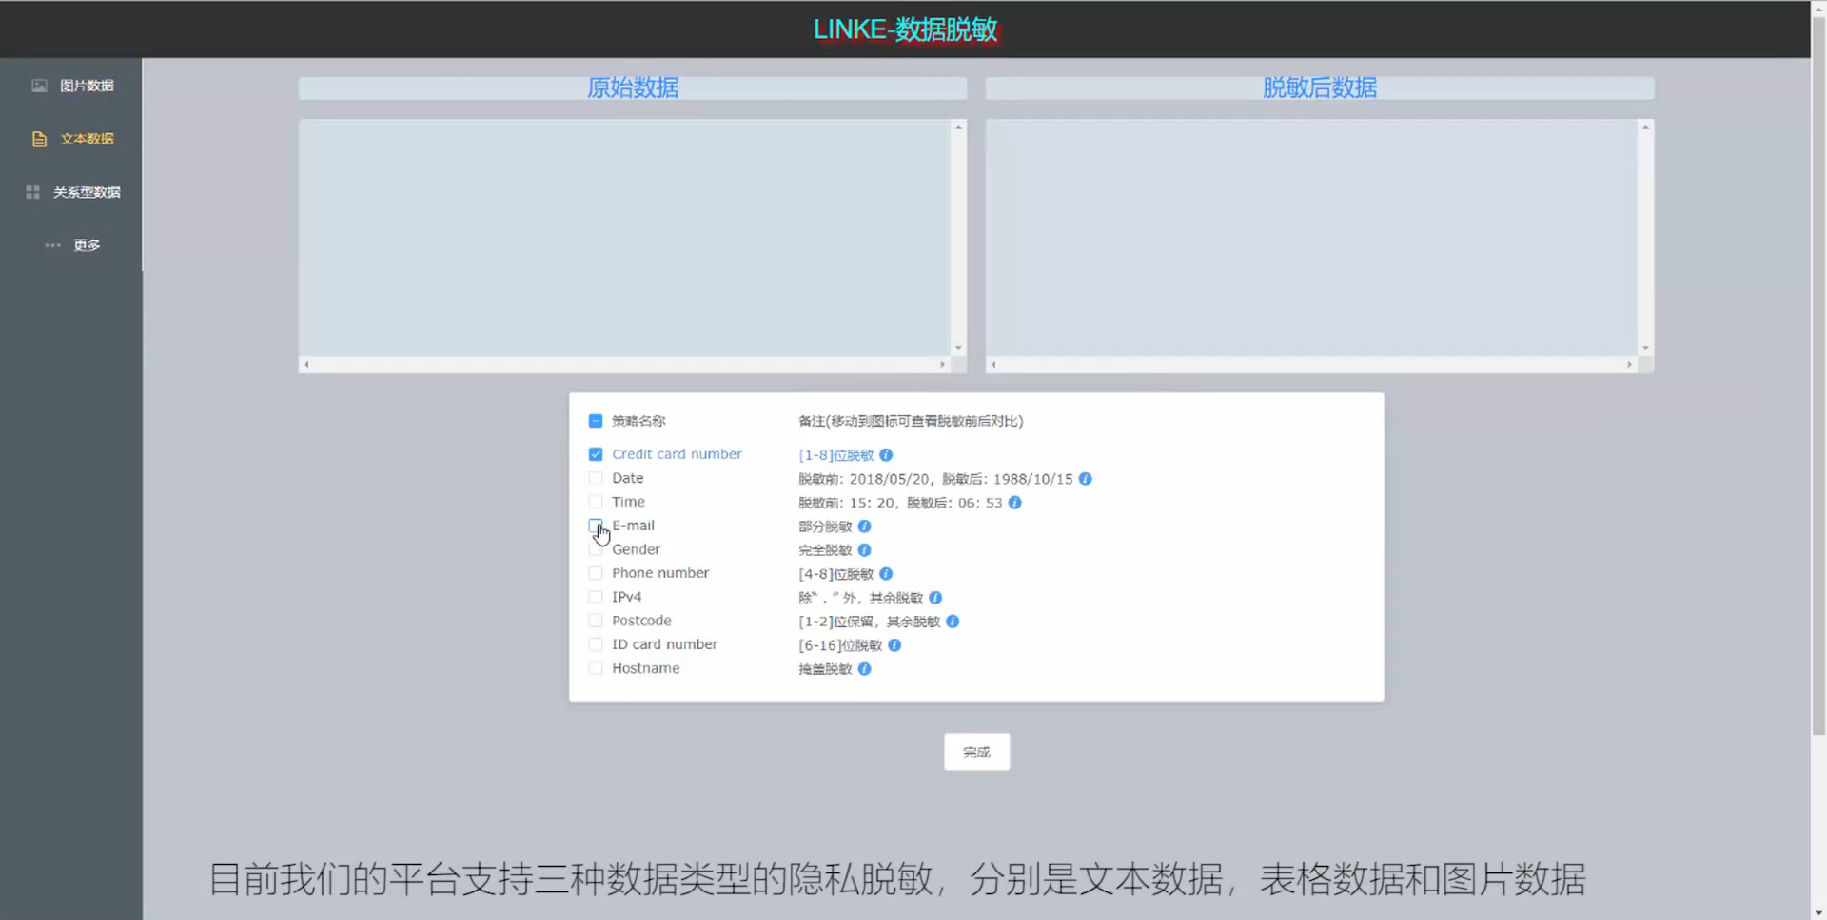
LINKE-数海星云

Slide 26
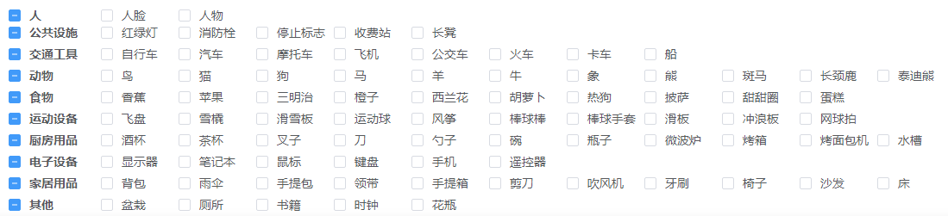
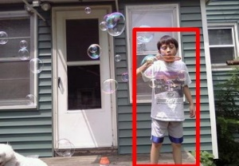
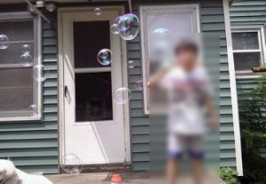
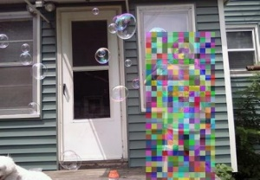
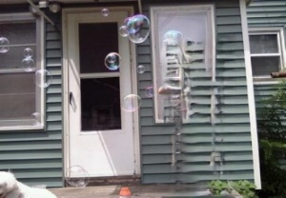
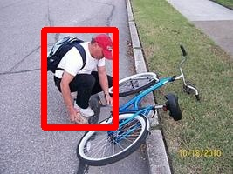
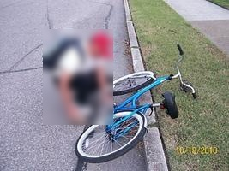
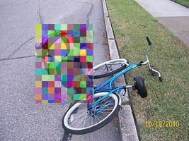
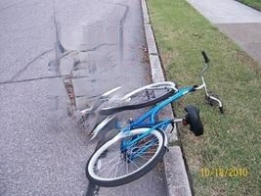
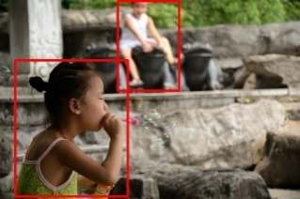



LINKE-数海星云
原始图片
模糊
马赛克
消去

Slide 27


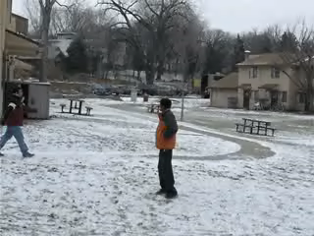


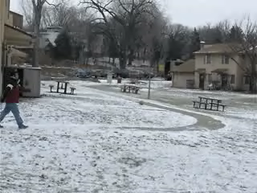
LINKE-数海星云

Slide 28
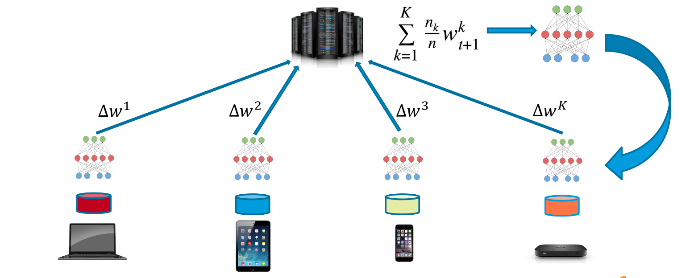
Extract features
Federated learning
https://miro.medium.com/max/3264/1*HaH611vAy2eB1e42vz3X4g.png

Slide 29
Inference Control Methods
不给/部分不给
Suppress
Break linkage
Monitor the queries: query restriction/auditing
给加密的
Secure Multiparty Computing
给不精准的
Change granularity: generalize/aggregate
Change accuracy: swapping/add noise (DP)
Extract features: federated learning
给合成的(Synthetic data）

Slide 30
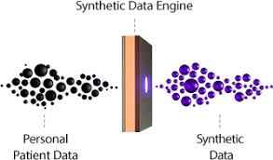
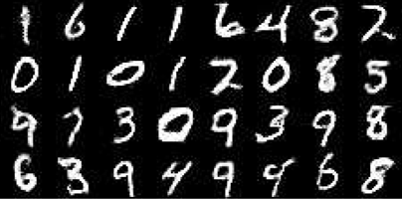
Synthetic data

Slide 31
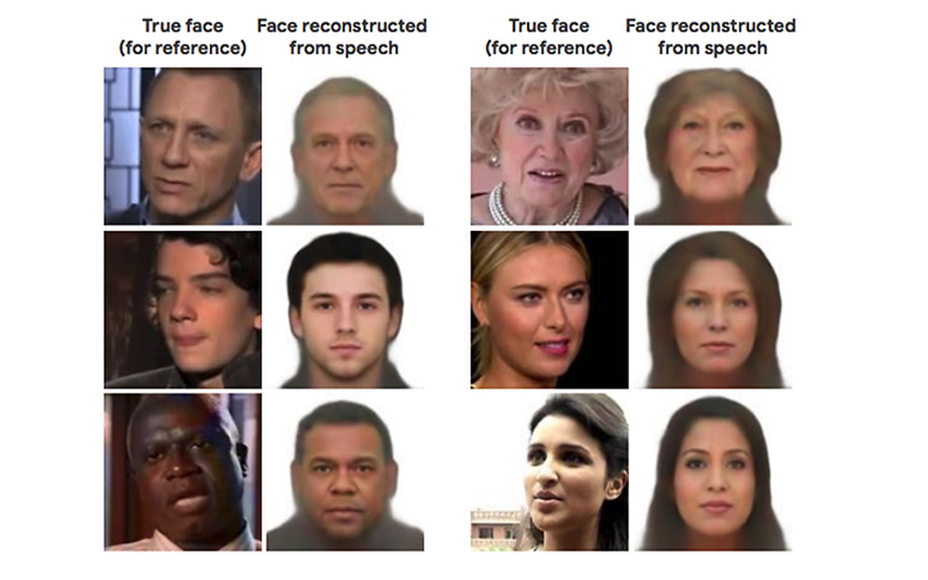
Synthetic data
https://thenewstack.io/speech2face-reconstructs-faces-using-only-voice-audio/

Slide 32

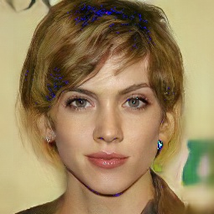

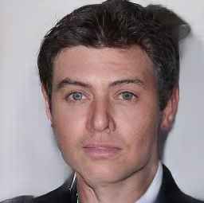

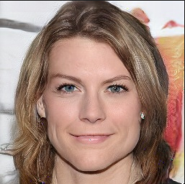
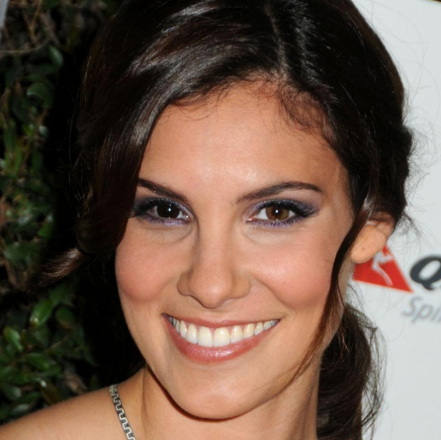
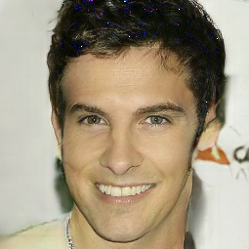
Synthetic data

Slide 33
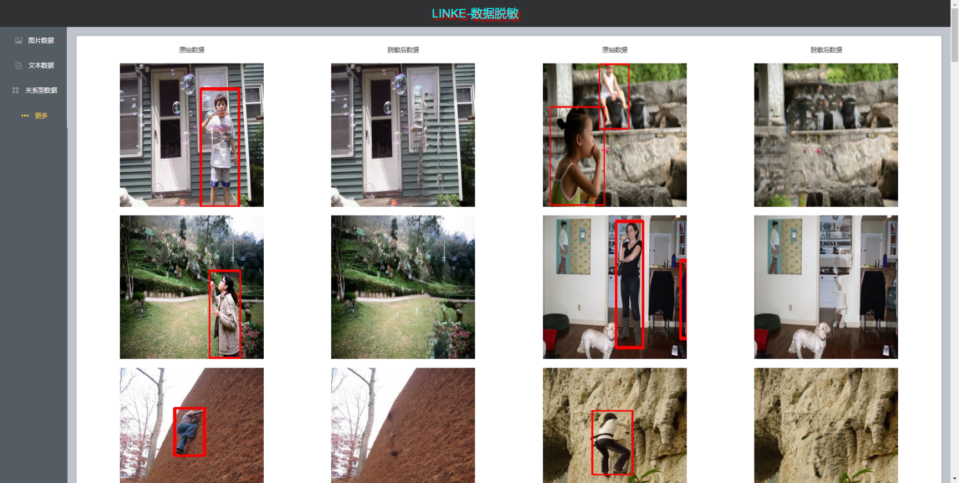


How to protect
2. 给加密的
3. 给不精准的
1.（部分）不给
4. 给合成的

Slide 34
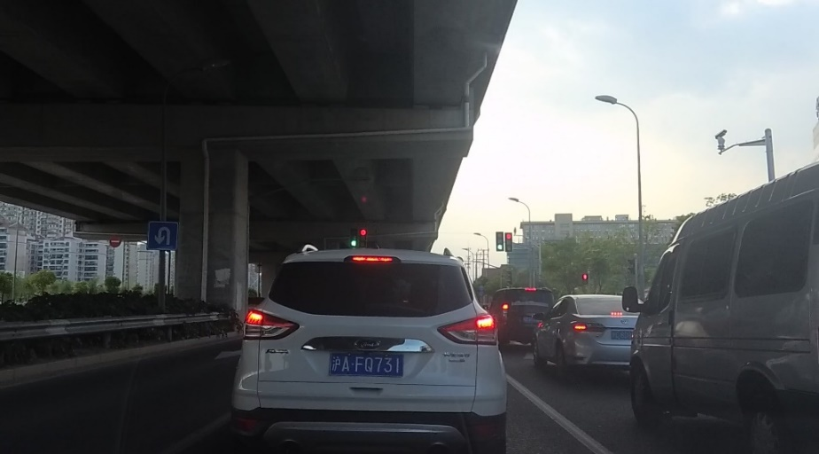



Synthetic data
自动驾驶数据脱敏—车牌脱敏
原始视频
隐私检测
隐私替换
脱敏视频

Slide 35
Which one is better?
 | Name | Age | Gender | Zip Code | Nationality | Condition
1 | Ann | 20-29 | Any | 130** | Asian | Heart disease
2 | Bruce | 20-29 | Any | 130** | Asian | Heart disease
3 | Cary | 20-29 | Any | 130** | Asian | Viral infection
4 | Dick | 20-29 | Any | 130** | Asian | Viral infection
5 | Eshwar | 40-59 | Any | 130** | Asian | Cancer
6 | Fox | 40-59 | Any | 14*** | Asian | Flu
7 | Gary | 40-59 | Any | 14*** | Asian | Heart disease
8 | Helen | 40-59 | Any | 14*** | Asian | Flu
9 | Igor | 30-39 | Any | 1322* | American | Cancer
10 | Jean | 30-39 | Any | 1322* | American | Cancer
11 | Ken | 30-39 | Any | 1322* | American | Cancer
12 | Lewis | 30-39 | Any | 1322* | American | Cancer
 | Name | Age | Gender | Zip Code | Nationality | Condition
1 | Ann | 28 | F | 13053 | Korean | Heart disease
2 | Bruce | 29 | M | 13068 | Chinese | Heart disease
3 | Cary | 21 | F | 13068 | Japanese | Viral infection
4 | Dick | 23 | M | 13053 | American | Viral infection
5 | Eshwar | 50 | M | 13053 | Indian | Cancer
6 | Fox | 55 | M | 14750 | Japanese | Flu
 | Name | Age | Gender | Zip Code | Nationality | Condition
1 | Ann | 28+2 | F | 13053 | Korean | Heart disease
2 | Bruce | 29-1 | M | 13068 | Chinese | Heart disease
3 | Cary | 21+1 | F | 13068 | Japanese | Viral infection
4 | Dick | 23-2 | M | 13053 | American | Viral infection
…

Slide 36
How Much
Privacy Definition
Utility Metric
Mechanisms and Algorithms

Slide 37
How Much
Privacy Definition
Utility Metric
Adversarial model
Mechanisms and Algorithms

Slide 38
Adversarial model
Adversaries:
Inside attackers: authorized users with malicious intent
Outside attackers: hackers, snoopers
Adversarial models:
Trusted: trusted & tamper-proof
Semi-honest: honest but curious
Untrusted/malicious: curious + actively modifies data and/or queries
Background Knowledge
The adversary may also have instance level background knowledge.
The adversary may also know demographic background data such as the probability of a condition given an age.

Slide 39
How Much
Incentives
Privacy Definition
Utility Metric
Adversarial model
Mechanisms and Algorithms

Slide 40
All the evolution we know of proceeds from the vague to the definite.
— Charles Sanders Peirce
Notes:
美国实用主义哲学的先驱者之一皮尔斯(Charles Sanders Peirce ,1839-1914)是符号学界公认的现代符号学理论的创始人之一
在哲学上，提出作为实用主义核心的意义理论，把观念的意义和实际的效果联系起来，断言一个观念的定义是该观念的可感觉的效果。后来，将实用主义易名为“实效主义”。在逻辑学方面有两大贡献，一是改进了希尔代数，一是发展了关系逻辑，即引入新的概念和符号，把关系逻辑组成为一个关系演算。
皮尔斯唯一的学术职位是1879-1884年在巴尔的摩的约翰斯。霍普金斯大学担任逻辑学讲师。这期间他完成数学工作包括逻辑，集合论，抽象代数和数学原理的贡献，他的工作至今还有影响，他在逻辑上的某些工作近来已被应用于人工智能。皮尔斯相信，研究数学可以开发大脑的想象力，抽象思维能力和归纳能力。

Slide 41
1. K-Anonymity
To protect data from linking attacks,
Samarati and Sweeney proposed k-anonymity.
[1] P. Samarati, “Protecting respondents’ identities in microdata release,” in Transactions on Knowledge and Data Engineering, pp. 1010–1027, 2001.
[2] L. Sweeney, “k-anonymity: A model for protecting privacy,” International Journal on Uncertainty, Fuzziness and Knowledge-based Systems, vol. 10, no. 5, pp. 557–570, 2002.
[3] Sweeney L, Achieving K-Anonymity Privacy Protection using Generalization and Suppression, International Journal on Uncertainty, Fuzziness and Knowledge-based Systems, Vol. 10, No. 5, 571-588, 2002.
[4] http://www.cs.emory.edu/~lxiong/cs573/index.html

Slide 42
Basic attempt: de-identification
Remove/replace “personally identifying information” (PII)
PII has no technical meaning or common definition
 | Name | Age | Gender | Zip Code | Nationality | Condition
1 | Ann | 28 | F | 13053 | Korean | Heart disease
2 | Bruce | 29 | M | 13068 | Chinese | Heart disease
3 | Cary | 21 | F | 13068 | Japanese | Viral infection
4 | Dick | 23 | M | 13053 | American | Viral infection
5 | Eshwar | 50 | M | 13053 | Indian | Cancer
6 | Fox | 55 | M | 14750 | Japanese | Flu
7 | Gary | 47 | M | 14562 | Chinese | Heart disease
8 | Helen | 49 | F | 14821 | Korean | Flu
9 | Igor | 31 | M | 13222 | American | Cancer
10 | Jean | 37 | F | 13227 | American | Cancer
11 | Ken | 36 | M | 13228 | American | Cancer
12 | Lewis | 35 | M | 13221 | American | Cancer

Slide 43
Basic attempt: de-identification
Remove/replace “personally identifying information” (PII)
PII has no technical meaning or common definition
Linking attack : 87% of the population of the United States can be uniquely identified on the basis of their five-digit zip code, gender, and date of birth.

Slide 44
Massachusetts GIC Incident
Massachusetts GIC released “anonymized” data on state employees’ hospital visit
Then Governor William Weld assured public on privacy
Age | Zip Code | Condition
28 | 13053 | AIDS
29 | 13068 | AIDS
21 | 13068 | Viral infection
23 | 13053 | Viral infection
50 | 13053 | Cancer
55 | 14750 | Flu
47 | 14562 | Heart disease
49 | 14821 | Flu
Anonymized

Slide 45
Massachusetts GIC Incident
Re-identification： then graduate student Sweeney linked the data with Voter registration data in Cambridge and identified Governor Weld’s record
Age | Zip Code | Condition
28 | 13053 | AIDS
29 | 13068 | AIDS
21 | 13068 | Viral infection
23 | 13053 | Viral infection
50 | 13053 | Cancer
55 | 14750 | Flu
47 | 14562 | Heart disease
49 | 14821 | Flu
 | Age | Zip Code
Ann | 28 | 13053
Cary | 21 | 13068
Dick | 23 | 13053
Helen | 49 | 14821

Slide 46
Massachusetts GIC Incident
Re-identification： then graduate student Sweeney linked the data with Voter registration data in Cambridge and identified Governor Weld’s record
Age | Zip Code | Condition
28 | 13053 | AIDS
29 | 13068 | AIDS
21 | 13068 | Viral infection
23 | 13053 | Viral infection
50 | 13053 | Cancer
55 | 14750 | Flu
47 | 14562 | Heart disease
49 | 14821 | Flu
 | Age | Zip Code
Ann | 28 | 13053
Cary | 21 | 13068
Dick | 23 | 13053
Helen | 49 | 14821

Slide 47
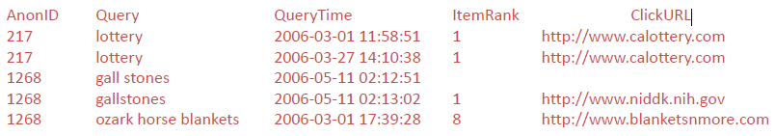
AOL Query Log Release
20 million Web search queries by AOL

Slide 48
AOL Query Log Release
User No. 4417749
“numb fingers”, “60 single men”, “dog that urinates on everything”, Several people names with last name Arnold, “homes sold in shadow lake subdivision gwinnett county georgia”
Thelma Arnold, a 62-year-old widow who lives in Lilburn, Ga., frequently researches her friends’ medical ailments and loves her dogs.

Slide 49
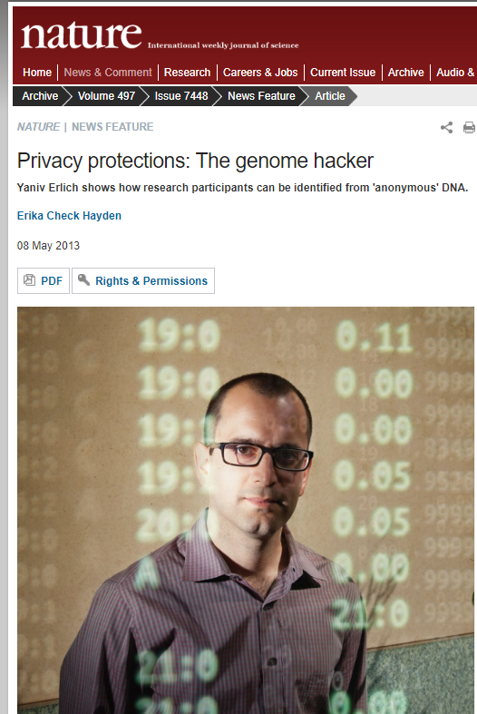
The Genome Hacker (2013)
Yaniv Erlich shows how research participants can be identified from 'anonymous' DNA by cross-referencing their data with publicly available information.
https://www.nature.com/news/privacy-protections-the-genome-hacker-1.12940

Slide 50


Linkage

Slide 51

Hide in a crowd
https://www.sohu.com/a/251511668_100097557

Slide 52

Hide in a crowd
https://www.sohu.com/a/251511668_100097557

Slide 53
An Example Data Table
 | Name | Age | Gender | Zip Code | Nationality | Condition
1 | Ann | 28 | F | 13053 | Korean | Heart disease
2 | Bruce | 29 | M | 13068 | Chinese | Heart disease
3 | Cary | 21 | F | 13068 | Japanese | Viral infection
4 | Dick | 23 | M | 13053 | American | Viral infection
5 | Eshwar | 50 | M | 13053 | Indian | Cancer
6 | Fox | 55 | M | 14750 | Japanese | Flu
7 | Gary | 47 | M | 14562 | Chinese | Heart disease
8 | Helen | 49 | F | 14821 | Korean | Flu
9 | Igor | 31 | M | 13222 | American | Cancer
10 | Jean | 37 | F | 13227 | American | Cancer
11 | Ken | 36 | M | 13228 | American | Cancer
12 | Lewis | 35 | M | 13221 | American | Cancer

Slide 54
Attribute Classification
Identifier attributes
Information that leads to a specific entity
 | Name | Age | Gender | Zip Code | Nationality | Condition
1 | Ann | 28 | F | 13053 | Korean | Heart disease
2 | Bruce | 29 | M | 13068 | Chinese | Heart disease
3 | Cary | 21 | F | 13068 | Japanese | Viral infection
4 | Dick | 23 | M | 13053 | American | Viral infection
5 | Eshwar | 50 | M | 13053 | Indian | Cancer
6 | Fox | 55 | M | 14750 | Japanese | Flu
7 | Gary | 47 | M | 14562 | Chinese | Heart disease
8 | Helen | 49 | F | 14821 | Korean | Flu
9 | Igor | 31 | M | 13222 | American | Cancer
10 | Jean | 37 | F | 13227 | American | Cancer
11 | Ken | 36 | M | 13228 | American | Cancer
12 | Lewis | 35 | M | 13221 | American | Cancer

Slide 55
Attribute Classification
Quasi-identifiers (Key attributes)
 | Name | Age | Gender | Zip Code | Nationality | Condition
1 | Ann | 28 | F | 13053 | Korean | Heart disease
2 | Bruce | 29 | M | 13068 | Chinese | Heart disease
3 | Cary | 21 | F | 13068 | Japanese | Viral infection
4 | Dick | 23 | M | 13053 | American | Viral infection
5 | Eshwar | 50 | M | 13053 | Indian | Cancer
6 | Fox | 55 | M | 14750 | Japanese | Flu
7 | Gary | 47 | M | 14562 | Chinese | Heart disease
8 | Helen | 49 | F | 14821 | Korean | Flu
9 | Igor | 31 | M | 13222 | American | Cancer
10 | Jean | 37 | F | 13227 | American | Cancer
11 | Ken | 36 | M | 13228 | American | Cancer
12 | Lewis | 35 | M | 13221 | American | Cancer

Slide 56
Attribute Classification
Quasi-identifiers
Pieces of information that are not of themselves unique identifiers, but are sufficiently well correlated with an entity that they can be combined with other quasi-identifiers to create a unique identifier.
Age, gender, zip code, and nationality are called quasi-identifier attributes, because by looking at these attributes an adversary may potentially identify an individual in the data set.
May be known by an intruder from other sources.

Slide 57
Attribute Classification
Confidential or sensitive attributes
Assumed to be unknown to an intruder
 | Name | Age | Gender | Zip Code | Nationality | Condition
1 | Ann | 28 | F | 13053 | Korean | Heart disease
2 | Bruce | 29 | M | 13068 | Chinese | Heart disease
3 | Cary | 21 | F | 13068 | Japanese | Viral infection
4 | Dick | 23 | M | 13053 | American | Viral infection
5 | Eshwar | 50 | M | 13053 | Indian | Cancer
6 | Fox | 55 | M | 14750 | Japanese | Flu
7 | Gary | 47 | M | 14562 | Chinese | Heart disease
8 | Helen | 49 | F | 14821 | Korean | Flu
9 | Igor | 31 | M | 13222 | American | Cancer
10 | Jean | 37 | F | 13227 | American | Cancer
11 | Ken | 36 | M | 13228 | American | Cancer
12 | Lewis | 35 | M | 13221 | American | Cancer

Slide 58
Attribute Classification
Identifier attributes
Ex: Name and SSN
Information that leads to a specific entity
Quasi-identifier attributes
Ex: Zip Code and Age
May be known by an intruder
Confidential or sensitive attributes
Ex: Principal Diagnosis and Annual Income
Assumed to be unknown to an intruder

Slide 59
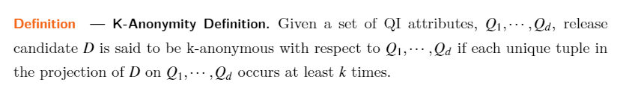
K-Anonymity Definition
QI-cluster – all the tuples with identical combination of quasi-identifier attribute values in that microdata.
K-anonymity property for a masked microdata (MM) is satisfied if every QI-cluster in MM contains k or more tuples.

Slide 60
QI-cluster, #?
 | Name | Age | Gender | Zip Code | Nationality | Condition
1 | Ann | 20-29 | Any | 130** | Asian | Heart disease
2 | Bruce | 20-29 | Any | 130** | Asian | Heart disease
3 | Cary | 20-29 | Any | 130** | Asian | Viral infection
4 | Dick | 20-29 | Any | 130** | Asian | Viral infection
5 | Eshwar | 40-59 | Any | 130** | Asian | Cancer
6 | Fox | 40-59 | Any | 14*** | Asian | Flu
7 | Gary | 40-59 | Any | 14*** | Asian | Heart disease
8 | Helen | 40-59 | Any | 14*** | Asian | Flu
9 | Igor | 30-39 | Any | 1322* | American | Cancer
10 | Jean | 30-39 | Any | 1322* | American | Cancer
11 | Ken | 30-39 | Any | 1322* | American | Cancer
12 | Lewis | 30-39 | Any | 1322* | American | Cancer

Slide 61
3 QI-clusters
 | Name | Age | Gender | Zip Code | Nationality | Condition
1 | Ann | 20-29 | Any | 130** | Asian | Heart disease
2 | Bruce | 20-29 | Any | 130** | Asian | Heart disease
3 | Cary | 20-29 | Any | 130** | Asian | Viral infection
4 | Dick | 20-29 | Any | 130** | Asian | Viral infection
5 | Eshwar | 40-59 | Any | 130** | Asian | Cancer
6 | Fox | 40-59 | Any | 14*** | Asian | Flu
7 | Gary | 40-59 | Any | 14*** | Asian | Heart disease
8 | Helen | 40-59 | Any | 14*** | Asian | Flu
9 | Igor | 30-39 | Any | 1322* | American | Cancer
10 | Jean | 30-39 | Any | 1322* | American | Cancer
11 | Ken | 30-39 | Any | 1322* | American | Cancer
12 | Lewis | 30-39 | Any | 1322* | American | Cancer

Slide 62
K-Anonymity Definition
Every QI-cluster in MM contains k or more tuples.
 | Name | Age | Gender | Zip Code | Nationality | Condition
1 | Ann | 20-29 | Any | 130** | Asian | Heart disease
2 | Bruce | 20-29 | Any | 130** | Asian | Heart disease
3 | Cary | 20-29 | Any | 130** | Asian | Viral infection
4 | Dick | 20-29 | Any | 130** | Asian | Viral infection
5 | Eshwar | 40-59 | Any | 130** | Asian | Cancer
6 | Fox | 40-59 | Any | 14*** | Asian | Flu
7 | Gary | 40-59 | Any | 14*** | Asian | Heart disease
8 | Helen | 40-59 | Any | 14*** | Asian | Flu
9 | Igor | 30-39 | Any | 1322* | American | Cancer
10 | Jean | 30-39 | Any | 1322* | American | Cancer
11 | Ken | 30-39 | Any | 1322* | American | Cancer
12 | Lewis | 30-39 | Any | 1322* | American | Cancer

Slide 63
Example
ID | Age | Zip | Sex | Illness
1 | 50 | 41076 | Female | AIDS
2 | 30 | 41099 | Male | Diabetes
3 | 30 | 41099 | Male | AIDS
4 | 20 | 41076 | Male | Asthma
5 | 20 | 41076 | Male | Asthma
6 | 50 | 41076 | Female | Diabetes
7 | 50 | 41076 | Female | Tuberculosis
K=?

Slide 64
Example
ID | Age | Zip | Sex | Illness
1 | 50 | 41076 | Female | AIDS
2 | 30 | 41099 | Male | Diabetes
3 | 30 | 41099 | Male | AIDS
4 | 20 | 41076 | Male | Asthma
5 | 20 | 41076 | Male | Asthma
6 | 50 | 41076 | Female | Diabetes
7 | 50 | 41076 | Female | Tuberculosis
K=2

Slide 65
Achieving k-Anonymity: k-anonymization
Generalization
Replace specific quasi-identifiers with more general values until get k identical values
Example: area code instead of phone number
Partition ordered-value domains into intervals
Suppression
When generalization causes too much information loss
Lots of algorithms in the literature
Aim to minimize various form of information loss

Slide 66
Domain and Value Generalization Hierarchies
Z₂ = {*****}
*****
482**
410**
Z₁ = {482**, 410**}
48201
41075
41076
41088
41099
Z₀ = {48201, 41075, 41076, …}
S₁ = {*}
*
S₀ = {male, female}
male
female
[Samarati 2001, Sweeney 2002]

Slide 67
Generalization Types
All Attributes:
Full domain generalization [Samarati 2001, LeFevre 2006] Given a fixed VGH, guarantee that all values of a particular attribute in V belong to the same level.
Iyengar generalization [Iyengar 2002] A more flexible scheme, which also uses a fixed VGH, but allows different values of an attribute to be generalized to different levels.
Cell-level generalization [Lunacek 2006]
Numerical Attributes
Predefined hierarchy [Iyengar 2002]
Computed hierarchy [LeFevre 2006]

Slide 68
2-Anonymity
Tuple | Age | ZipCode | Sex
r₁ | 20-50 | ***** | Male
r₂ | 20-50 | ***** | Female
r₃ | 20-50 | ***** | Female
r₄ | 20-50 | ***** | Male
r₅ | 20-50 | ***** | Male
Full domain generalization
Tuple | Age | ZipCode | Sex
r₁ | 50 | 41076 | Male
r₂ | 30 | 41075 | Female
r₃ | 30 | 41099 | Female
r₄ | 20 | 48201 | Male
r₅ | 20 | 41075 | Male
Tuple | Age | ZipCode | Sex
r₁ | 20-30 | 410** | Male
r₂ | 20-30 | 410** | Female
r₃ | 30-40 | ***** | Female
r₄ | 30-40 | ***** | Male
r₅ | 30-40 | ***** | Male
Cell-level generalization

Slide 69
Attacks Against K-Anonymity
Unsorted Matching Attack
This attack is based on the order in which tuples appear in the released table. [Sweeney 2002]
Solution: Randomly sort the tuples before releasing.
Temporal Attack
Adding or removing tuples may compromise k-anonymity protection [Sweeney 2002].

Slide 70
Attacks Against K-Anonymity
Complementary Release Attack
Different releases can be linked together to compromise k-anonymity [Sweeney 2002].
Solution: Consider all of the released tables before release the new one, and try to avoid linking.
Other data holders may release some data that can be used in this kind of attack. Generally, this kind of attack is hard to be prohibited completely.

Slide 71
Multi-view release
To increase data utility, the data publisher may release multiple views of a single original data set, where the released views are outputs of one (or more) of the above sanitization mechanisms.

Slide 72
Attacks Against K-Anonymity
A 3-anonymous patient table
Zipcode | Age | Disease
476** | 2* | Heart Disease
476** | 2* | Heart Disease
476** | 2* | Heart Disease
4790* | ≥40 | Flu
4790* | ≥40 | Heart Disease
4790* | ≥40 | Cancer
476** | 3* | Heart Disease
476** | 3* | Cancer
476** | 3* | Cancer

Slide 73
Attacks Against K-Anonymity
Homogeneity Attack
Zipcode | Age | Disease
476** | 2* | Heart Disease
476** | 2* | Heart Disease
476** | 2* | Heart Disease
4790* | ≥40 | Flu
4790* | ≥40 | Heart Disease
4790* | ≥40 | Cancer
476** | 3* | Heart Disease
476** | 3* | Cancer
476** | 3* | Cancer
Bob
Zipcode | Age
47678 | 27

Slide 74
Attacks Against K-Anonymity
Homogeneity Attack
Zipcode | Age | Disease
476** | 2* | Heart Disease
476** | 2* | Heart Disease
476** | 2* | Heart Disease
4790* | ≥40 | Flu
4790* | ≥40 | Heart Disease
4790* | ≥40 | Cancer
476** | 3* | Heart Disease
476** | 3* | Cancer
476** | 3* | Cancer
Bob
Zipcode | Age
47678 | 27

Slide 75
Attacks Against K-Anonymity
Homogeneity Attack
Zipcode | Age | Disease
476** | 2* | Heart Disease
476** | 2* | Heart Disease
476** | 2* | Heart Disease
4790* | ≥40 | Flu
4790* | ≥40 | Heart Disease
4790* | ≥40 | Cancer
476** | 3* | Heart Disease
476** | 3* | Cancer
476** | 3* | Cancer
Bob
Zipcode | Age
47678 | 27
Background Knowledge Attack
Carl (Japanese)
Zipcode | Age
47673 | 36

Slide 76
Attacks Against K-Anonymity
Homogeneity Attack
Zipcode | Age | Disease
476** | 2* | Heart Disease
476** | 2* | Heart Disease
476** | 2* | Heart Disease
4790* | ≥40 | Flu
4790* | ≥40 | Heart Disease
4790* | ≥40 | Cancer
476** | 3* | Heart Disease
476** | 3* | Cancer
476** | 3* | Cancer
Bob
Zipcode | Age
47678 | 27
Background Knowledge Attack
Carl (Japanese)
Zipcode | Age
47673 | 36

Slide 77
Attacks Against K-Anonymity
K-Anonymity protects against identity disclosure but not provide sufficient protection against attribute disclosure
K-Anonymity does not provide privacy if
Sensitive values in an equivalence class lack diversity [ Truta 2006, Machanavajjhala 2006].
The attacker has background knowledge [Machanavajjhala 2006].

Slide 78
P-Sensitive K-Anonymity Definition
P-sensitive K-anonymity property
A MM satisfies p-sensitive k-anonymity property if it
satisfies k-anonymity and
the number of distinct attribute values for each sensitive attribute is at least p within the same QI-cluster from the MM [Truta 2006].

Slide 79
P-Sensitive K-Anonymity
A 3-anonymous patient table
Zipcode | Age | Disease
476** | 2* | Heart Disease
476** | 2* | Heart Disease
476** | 2* | Heart Disease
4790* | ≥40 | Flu
4790* | ≥40 | Heart Disease
4790* | ≥40 | Cancer
476** | 3* | Heart Disease
476** | 3* | Cancer
476** | 3* | Cancer
P=?

Slide 80
P-Sensitive K-Anonymity
A 3-anonymous patient table
Zipcode | Age | Disease
476** | <40 | Heart Disease
476** | <40 | Heart Disease
476** | <40 | Heart Disease
4790* | ≥40 | Flu
4790* | ≥40 | Heart Disease
4790* | ≥40 | Cancer
476** | <40 | Heart Disease
476** | <40 | Cancer
476** | <40 | Cancer
P=?

Slide 81
Revisiting the example
Homogeneity Attack
Zipcode | Age | Disease
476** | <40 | Heart Disease
476** | <40 | Heart Disease
476** | <40 | Heart Disease
4790* | ≥40 | Flu
4790* | ≥40 | Heart Disease
4790* | ≥40 | Cancer
476** | <40 | Heart Disease
476** | <40 | Cancer
476** | <40 | Cancer
Bob
Zipcode | Age
47678 | 27
Background Knowledge Attack
Carl (Japanese)
Zipcode | Age
47673 | 36

Slide 82
2. l-Diversity
To protect data from attackers when the sensitive information lacks diversity.
[1] Machanavajjhala, Ashwin, Daniel Kifer, Johannes Gehrke, and Muthuramakrishnan Venkitasubramaniam. "l-diversity: Privacy beyond k-anonymity." ACM Transactions on Knowledge Discovery from Data (TKDD) 1, no. 1 (2007): 3-es

Slide 83
l-Diversity
There are at least l-distinct sensitive values.
… | Cancer
… | Heart Disease
… | Cancer
… | Cancer
… | Cancer
… | Cancer
… | Cancer

Slide 84
l-Diversity
There are at least l-distinct sensitive values.
… | Cancer
… | Heart Disease
… | Cancer
… | Cancer
… | Cancer
… | Cancer
… | Cancer
90% records have cancer

Slide 85
l-Diversity
Protect against attribute disclosure
Each QI cluster has at least l well-represented sensitive values.
1. Distinct l-diversity
There are at least l-distinct sensitive values.
Doesn’t prevent the probabilistic inference attacks
… | Cancer
… | Heart Disease
… | Cancer
… | Cancer
… | Cancer
… | Cancer
… | Cancer
90% records have cancer

Slide 86
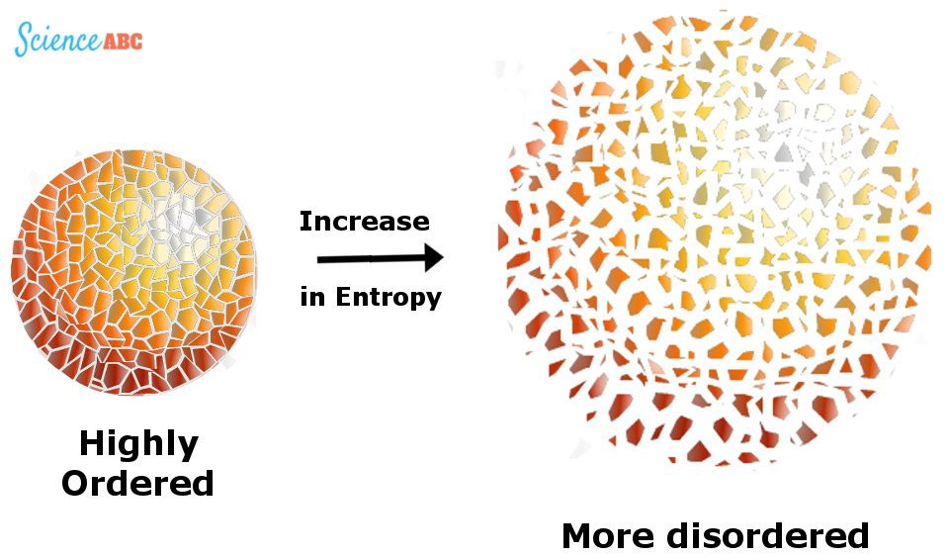

Slide 87
2. Entropy l-diversity
Each QI cluster not only must have enough different sensitive values, but also the different sensitive values must be distributed evenly enough.
The entropy of the distribution of sensitive values in each QI cluster is at least log(l).
Sometimes this maybe too restrictive. When some values are very common, the entropy of the entire table may be very low.

Slide 88
3. Recursive (c,l)-diversity
The most frequent value does not appear too frequently, while less common values are ensured to not appear too infrequently.
Let s₁, . . . , s_{m} be the possible values of the sensitive attribute S in a group of tuples with generalized QI value q*.
We sort the counts n(q*,s₁), . . . , n(q*,s_{m}) in descending order and name the elements of the resulting sequence r₁, . . . , r_{m}.
(c, 2)-diverse: r₁<c(r₂+r₃+…+r_{m}) should be true, where r_{i} is frequency.
(c, l)-diversity: r₁<c(r_{l}+r_{l+1}+…+r_{m}) should be true.
The recursive (c, l)-diversity, thus, can be interpreted in terms of adversarial background knowledge. It guards against all adversaries who possess at most l− 2 statements of the form “Bob does not have heart disease”.
Negative/Positive Disclosure-Recursive (c₁, c₂, l)-Diversity

Slide 89
Positive & Negative Disclosure
Positive Disclosure: Publishing the table T ⋆ that was derived from T results in a positive disclosure if the adversary can correctly identify the value of a sensitive attribute with high probability
Negative disclosure: Publishing the table T ⋆ that was derived from T results in a negative disclosure if the adversary can correctly eliminate some possible values of the sensitive attribute with high probability

Slide 90
Limitations of l-Diversity & p-sensitive k-anonymity
Attribute disclosure not completely prevented.
Skewness Attack [Li 2007]
Two sensitive values
HIV positive (1%) and HIV negative (99%).
Serious privacy risk
Consider an equivalence class that contains a large number of positive records compared to negative records.
l-diversity & p-sensitive k-anonymity does not differentiate
Equivalence class 1: 49 positive + 1 negative.
Equivalence class 2: 1 positive + 49 negative.

Slide 91
Neither Necessary, Nor Sufficient
Original Data
Anonymization A
Anonymization A
… | HIV-
… | HIV-
… | HIV-
… | HIV-
… | HIV+
… | HIV-
… | HIV-
… | HIV-
… | HIV-
… | HIV-
Q1 | HIV+
Q1 | HIV-
Q1 | HIV+
Q1 | HIV-
Q1 | HIV+
Q1 | HIV-
… | HIV-
… | HIV-
… | HIV-
… | HIV-
Q1 | HIV-
Q1 | HIV-
Q1 | HIV-
Q1 | HIV-
Q1 | HIV+
Q1 | HIV-
… | HIV-
… | HIV-
… | HIV-
… | HIV-
99% have HIV-
Diverse, but leak a lot of information
Not diverse, but not leak anything

Slide 92
Similarity Attack
Bob
Zip | Age
47678 | 27
Zipcode | Age | Salary | Disease
476** | 2* | 20K | Gastric Ulcer
476** | 2* | 30K | Gastritis
476** | 2* | 40K | Stomach Cancer
4790* | ≥40 | 50K | Gastritis
4790* | ≥40 | 100K | Flu
4790* | ≥40 | 70K | Bronchitis
476** | 3* | 60K | Bronchitis
476** | 3* | 80K | Pneumonia
476** | 3* | 90K | Stomach Cancer
Conclusion
Bob’s salary is in [20k,40k], which is relative low.
Bob has some stomach-related disease.
Semantic meanings of sensitive values not considered.

Slide 93
Multiple Sensitive Attributes
Previous discussions only addressed single sensitive attributes.
Suppose S and V are two sensitive attributes, and consider the QI cluster with the following tuples:
To address this problem we can add the additional sensitive attributes to the quasi-identifier.
Q | S₁ | V₁
Q | S₁ | V₂
Q | S₂ | V₃
Q | S₃ | V₃

Slide 94
Bayes-Optimal privacy
The attributes in the input table are considered to be partitioned into non-sensitive QI attributes (called Q) and sensitive attributes (called S). The adversary is assumed to know the complete joint distribution f of Q and S.
Publishing a generalized table breaches privacy if the adversary’s prior belief in an individual’s sensitive attribute is very different from the adversary’s posterior belief after seeing the published generalized table.

Slide 95
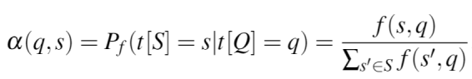
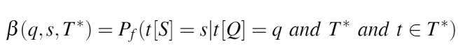
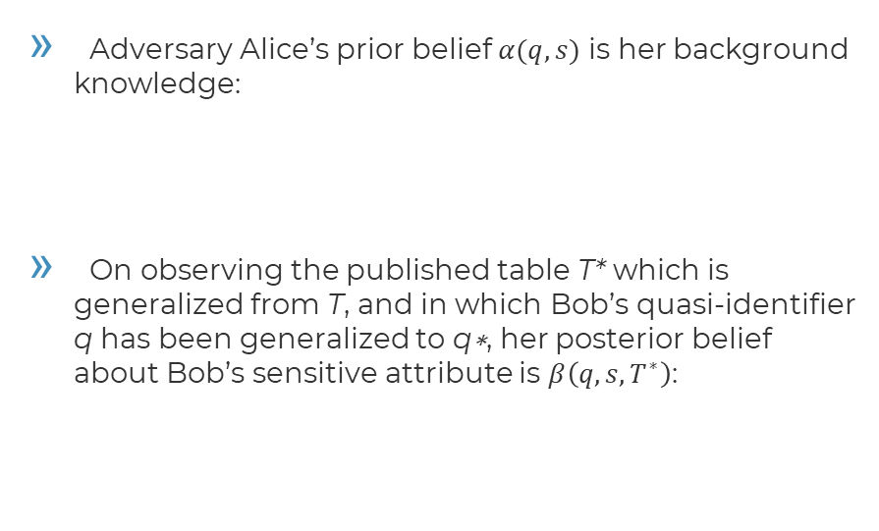
Bayes-Optimal privacy
Adversary Alice’s prior belief $α(q,s)$ is her background knowledge:
On observing the published table T* which is generalized from T, and in which Bob’s quasi-identifier q has been generalized to q∗, her posterior belief about Bob’s sensitive attribute is $β\left(q,s,T^{∗}\right)$:

Slide 96
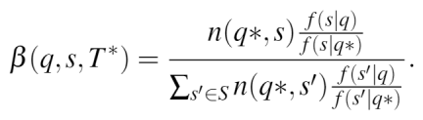
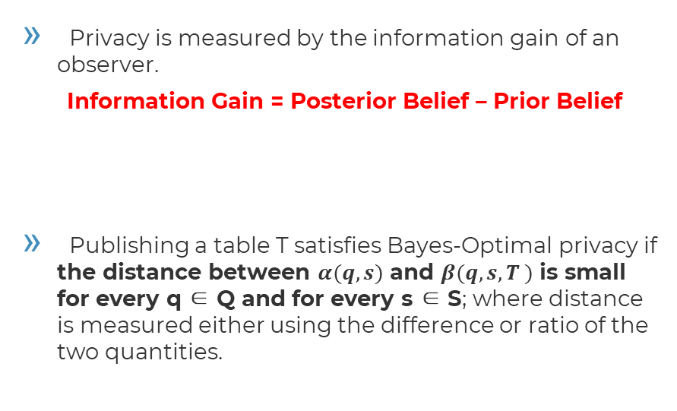
Bayes-Optimal privacy
Privacy is measured by the information gain of an observer.
Information Gain = Posterior Belief – Prior Belief
Publishing a table T satisfies Bayes-Optimal privacy if the distance between $α(q,s)$ and $β(q,s,T )$ is small for every q ∈ Q and for every s ∈ S; where distance is measured either using the difference or ratio of the two quantities.

Slide 97
Information Gain
Information Gain = Posterior Belief (S|Q&T*)– Prior Belief(S|Q)
Prior Belief : Alice thinks that Bob may has the disease, and 10% population in that area has the disease.
Posterior Belief: Alice knows Bob’s age, so he is in cluster 2. Based on T* she decides that it is quite likely (60%) that Bob has the disease.
476** | 20-30 | negative
476** | 20-30 | negative
476** | 20-30 | negative
476** | 20-30 | positive
476** | 20-30 | negative
479** | 31-40 | negative
479** | 31-40 | positive
479** | 31-40 | negative
479** | 31-40 | positive
479** | 31-40 | positive
… | … | …

Slide 98
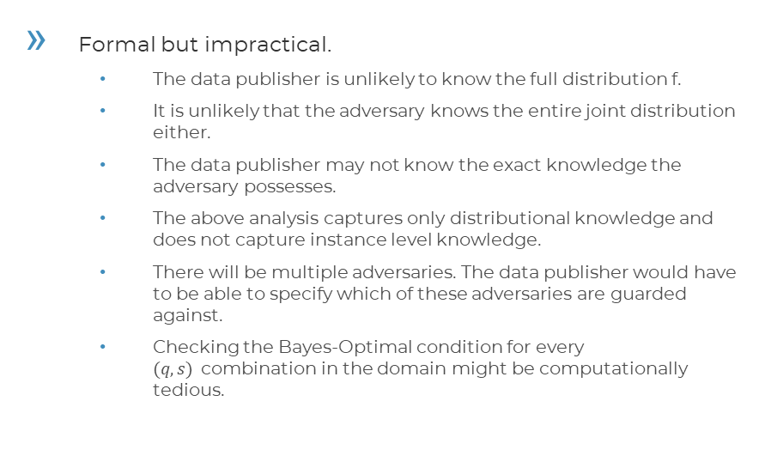
Bayes-Optimal privacy
Formal but impractical.
The data publisher is unlikely to know the full distribution f.
It is unlikely that the adversary knows the entire joint distribution either.
The data publisher may not know the exact knowledge the adversary possesses.
The above analysis captures only distributional knowledge and does not capture instance level knowledge.
There will be multiple adversaries. The data publisher would have to be able to specify which of these adversaries are guarded against.
Checking the Bayes-Optimal condition for every $(q,s)$combination in the domain might be computationally tedious.

Slide 99
3. t-Closeness
To protect data from attackers with domain knowledge.
[1] Li, Ninghui, Tiancheng Li, and Suresh Venkatasubramanian. "t-closeness: Privacy beyond k-anonymity and l-diversity." In 2007 IEEE 23rd International Conference on Data Engineering, pp. 106-115. IEEE, 2007.

Slide 100
Information Gain
Information Gain = Posterior Belief (S|Q&T*)– Prior Belief(S|Q)
B₀: Alice thinks that Bob may has the disease because he is acting sick
B₁: Based on P_{T*}, only 1% population has this disease. She believes that Bob is in that one percent.
B₂: Alice knows Bob’s age, so he is in cluster 2. P_{s} is the distribution of cluster 2.
Based on P she decides that it is quite likely that Bob has the disease.
476** | 20-30 | negative
476** | 20-30 | negative
476** | 20-30 | negative
476** | 20-30 | positive
476** | 20-30 | negative
479** | 31-40 | negative
479** | 31-40 | positive
479** | 31-40 | negative
479** | 31-40 | positive
479** | 31-40 | positive
… | … | …

Slide 101
t-Closeness
l-diversity requires that P has diversity.
We want to limit the gain between B₀ and B_{2.}
If the change between B₀ and B₁ is large, means that P_{T*} contains lots of new information. But P_{T*} is public. So we focus on the gain between B₁ and B_{2.}The closer P_{s} and P_{T*} are, the closer B₀₁ and B₂ are.
t-Closeness: distribution of sensitive attributes within each quasi-identifier group should be “close” to their distribution in the entire original database.
A QI cluster is said to have t-closeness
If the distance between P_{s} and P_{T*} is no more than a threshold t

Slide 102
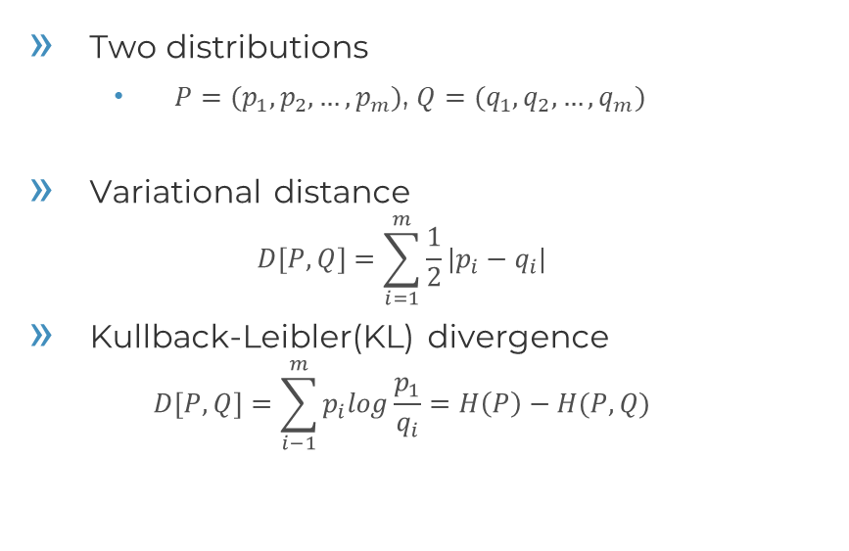
Distance of Two Probabilistic Distributions
Two distributions
$P=(p_{1},p_{2},…,p_{m})$, $Q=(q_{1}, q_{2},…,q_{m})$
Variational distance
$$D\left[P,Q\right]=\sum_{i=1}^{m}{\frac{1}{2}|p_{i}−q_{i}|}$$
Kullback-Leibler(KL) divergence
$$D\left[P,Q\right]=\sum_{i−1}^{m}{p_{i}log\frac{p_{1}}{q_{i}}}=H\left(P\right)−H(P,Q)$$

Slide 103
Distance of Two Probabilistic Distributions
Q = {3k,4k,5k,6k,7k,8k,9k,10k,11k}
P1 = {3k,4k,5k}
P2 = {6k,8k,11k}
P1 has more information leakage than P2 because there are fewer people in that salary range and thus they are easier to identify, thus we should have D[P1,Q]>D[P2,Q].
However, these algorithms just view 3k and 6k as different points and don’t attach semantic meaning to them. They would calculate this wrong.

Slide 104
Distance of Two Probabilistic Distributions
Earth Mover’s Distance
Suppose that several suppliers, each with a given amount of goods, are required to supply several consumers, each with a given limited capacity. For each supplier-consumer pair, the cost of transporting a single unit of goods is given. The transportation problem is then to find a least-expensive flow of goods from the suppliers to the consumers that satisfies the consumers' demand.
Similarly, here the problem is transforming one distribution to another with minimum work done.

Slide 105
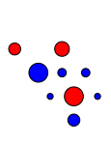

Distance of Two Probabilistic Distributions
Earth Mover’s Distance

Slide 106


Distance of Two Probabilistic Distributions
Earth Mover’s Distance

Slide 107

Distance of Two Probabilistic Distributions
Earth Mover’s Distance
There constraints guarantee that P is transformed to Q by the mass flow F. Once the transportation problem is solved, the EMD is defined to be the total work.
$$D\left[P,Q\right]=WORK\left(P,Q,F\right)=\sum_{i=1}^{m}{\sum_{j=1}^{m}{d_{ij}f_{ij}}}$$
$$f_{ij}≥0, 1≤i≤m, 1≤j≤m \left(c1\right)$$
$$p_{i}−\sum_{j=1}^{m}{f_{ij}}+\sum_{i=1}^{m}{f_{ji}}=q_{i} \left(c2\right)$$
$$\sum_{i=1}^{m}{\sum_{j=1}^{m}{f_{ij}}=\sum_{i=1}^{m}{p_{i}}=\sum_{i=1}^{m}{q_{i}}=1 (c3)}$$

Slide 108
Distance of Two Probabilistic Distributions
Numerical Distance
Ordered Distance: Distance between 2 numerical attributes (e.g. age) is based on the number of values between them in the total order.
Categorical Distance
Equal distance: for categorical attributes (ie diseases), order does not always matter. We can either view the ground distance between 2 categorical attributes as always being 1.
Hierarchical distance: H is the height of the domain hierarchy. The distance between two leaves is defined to be level(v1,v2)/H where level (v1,v2) is the height of the lowest common ancestor node.

Slide 109
Properties of t-closeness
Generalization property: If A and B are generalizations on the table T such that A is more general than B and T satisfies t-closeness using B, then T also satisfies t-closeness using A.
Subset property: If C is a set of attributes in the table T and if T satisfies t-closeness with respect to C, then T also satisfies t-closeness with respect to any set of attributes D such that D is a subset of C.

Slide 110
k-Anonymous, l-diverse, t-close Dataset
Is it secure?
476** | HIV- | Heart Disease
476** | HIV- | Flu
476** | HIV- | Cancer
476** | HIV- | Flu
476** | HIV+ | Heart Disease
479** | HIV- | Cancer
479** | HIV- | Heart Disease
479** | HIV+ | Flu
479** | HIV- | Heart Disease
479** | HIV- | Flu

Slide 111
Issues with Syntactic Privacy Notions
Syntactic
Focuses on data transformation, not on what can be learned from the anonymized dataset
“k-anonymous” dataset (or its variants) can leak sensitive information
“Quasi-identifier” fallacy
Assumes a priori that attacker will not know certain information about his target
Any attribute can be a potential quasi-identifier (AOL example)

Slide 112
4. Definitions with Background Knowledge
What the adversary knows.
[1] A. Evfimievski, J. Gehrke, and R. Srikant, “Limiting privacy breaches in privacy-preserving data mining,” in Proceedings of the 22nd ACM SIGMODSIGACT-SIGART Symposium on Principles of Database Systems (PODS), 2003.
[2] D. Martin, D. Kifer, A. Machanavajjhala, J. Gehrke, and J. Halpern, “Worst case background knowledge for privacy preserving data publishing,” in Proceedings of the IEEE International Conference on Data Engineering (ICDE), 2007.
[3] B.-C. Chen, K. LeFevre, and R. Ramakrishnan, “PrivacySkyline: Privacy with multidimensional adversarial knowledge,” in Proceedings of the 33rd International Conference on Very Large Databases (VLDB), 2007.
[4] C. Dwork, “Differential privacy,” in ICALP, 2006.

Slide 113
Questions
How does a data publisher decide which attributes should be included in the set of QI attributes?
QI attributes are just a special case of background knowledge.
k-anonymity considered background knowledge quantified by the set of QI attributes.
l-Diversity considered adversaries possessing negation statements in addition to QI attributes.
“Bob does not have heart disease”
t-Closeness considered adversaries having some prior belief in an individual’s sensitive attribute.
“Bob has 30% probability of having heart disease”

Slide 114

Background Knowledge
In general, one can describe background knowledge using Boolean logic sentences and seek to provide privacy protection against an adversary who knows a certain number of such sentences.
To understand whether D∗ is safe for release, we consider an adversary whose goal is to predict whether a target individual t has a target sensitive value s. The adversary has access to the release candidate D∗, as well as his own knowledge K.
A robust privacy criterion should place an upper bound on the adversary’s confidence in predicting any individual t to have sensitive value s.
Breach probability:

Slide 115
Boolean Background Knowledge
Pr(Eshwar has Cancer |D∗) = 1/4
K: Eshwar doesn’t have flu:
Pr(Eshwar has Cancer |K,D∗) = 1/2
 | Name | Age | Gender | Zip Code | Nationality | Condition
1 | Ann | 20-29 | Any | 130** | Asian | Heart disease
2 | Bruce | 20-29 | Any | 130** | Asian | Heart disease
3 | Cary | 20-29 | Any | 130** | Asian | Viral infection
4 | Dick | 20-29 | Any | 130** | Asian | Viral infection
5 | Eshwar | 40-59 | Any | 130** | Asian | Cancer
6 | Fox | 40-59 | Any | 14*** | Asian | Flu
7 | Gary | 40-59 | Any | 14*** | Asian | Heart disease
8 | Helen | 40-59 | Any | 14*** | Asian | Flu
9 | Igor | 30-39 | Any | 1322* | American | Cancer
10 | Jean | 30-39 | Any | 1322* | American | Cancer
11 | Ken | 30-39 | Any | 1322* | American | Cancer
12 | Lewis | 30-39 | Any | 1322* | American | Cancer

Slide 116
Specification of Adversarial Knowledge
Difficulty: the data publisher does not know precisely what knowledge an adversary has.
Martin et al. proposed the use of a language for expressing such knowledge: quantify the amount of knowledge an adversary could have, and to release data that are resilient to a certain amount of knowledge regardless of the specific content of this knowledge.
Lbasic(k) to be the set of all possible conjunctions of k implications :

Slide 117


(c, k)-safety
Given knowledge threshold $k > 0$and confidence threshold $c ∈\left[0, 1\right]$, release candidate $D^{∗}$ is (c,k)-safety if
where T is the set of individuals involved in D and S is the set of sensitive attribute values.
Problem: Lbasic(k) is not intuitive, it hard to set an appropriate k value in practice.

Slide 118

3D privacy criterion
Quantify possible adversarial knowledge from three intuitive dimensions.
Language $L_{t,s}(l,k,m)$ to be the set of all logic sentences, each of which represents an adversary that knows:
(1) $l$sensitive values that the target individual $t$ does not have,
(2) the sensitive values of $k$ other individuals,
(3) $m$ individuals in $t$’s same-value family for a sensitive value s (meaning that we can be sure that t has sensitive value s if any one of those m individuals has s, especially if s is a contagious disease).

Slide 119


3D privacy criterion
Given knowledge threshold $(l,k,m)$and confidence threshold $c∈\left[0,1\right]$, release candidate $D^{∗}$is safe if
What is the relation with k-anonymity and l-diversity?

Slide 120

3D privacy criterion
3D privacy → k-anonymity
identities are considered to be the sensitive values, the knowledge threshold is $(l=?,k=?,m=?)$and the confidence threshold $c=1,$ for all sensitive values.
3D privacy → (c,l)-diversity
the knowledge threshold is $(l=?,k=?,m=?)$and the confidence threshold is $?$, for all sensitive values.
(c, l)-diversity: r₁<c(r_{l}+r_{l+1}+…+r_{m}).

Slide 121

3D privacy criterion
3D privacy → k-anonymity
identities are considered to be the sensitive values, the knowledge threshold is $(0, k−2, 0)$and the confidence threshold $c=1,$ for all sensitive values.
k-anonymity provides privacy protection against any adversarial knowledge about the identities of k − 2 individuals.
3D privacy → (c,l)-diversity
the knowledge threshold is $( l− 2, 0, 0)$and the confidence threshold is $c/(c + 1)$, for all sensitive values.
(c, l)-diversity: r₁<c(r_{l}+r_{l+1}+…+r_{m}). The recursive (c, l)-diversity guards against all adversaries who possess at most l− 2 statements of the form “Bob does not have heart disease”

Slide 122


Computation of Breach Probabilities
Privacy breach: $\operatorname{Pr}\left(t has s | K,D^{∗}\right)$is generally computed based on the random world assumption.
Given a release candidate $D^{∗}$, each possible original data $D$ that can produce $D^{∗}$ by applying the sanitization mechanism to $D$ is called a possible world of $D^{∗}$, and each possible world is equally likely.
Compute max $Pr$: analyze the necessary conditions of the maximum, dynamic programming.

Slide 123
Probabilistic Background Knowledge
Adversaries may possess probabilistic knowledge about parts of the domain.
The adversary’s background knowledge is captured in terms of the prior probability, and additional information due to the access to D* represented by the posterior probability.

Slide 124

(α,β)-privacy
Let $R$be an algorithm that takes as input $u∈D_{U}$ and outputs $v∈D_{V}$. $R$ is said to allow an
upward (α,β)-privacy breach with respect to a predicate $∅$ if for some probability distribution $f$,
downward (α,β)-privacy breach with respect to a predicate $∅$ if for some probability distribution $f$,
$R$ is said to satisfy (α,β)-privacy if it does not allow any (α,β)-privacy breach for any predicate $∅$.

Slide 125
Positive & Negative Disclosure
Positive Disclosure: Publishing the table T ⋆ that was derived from T results in a positive disclosure if the adversary can correctly identify the value of a sensitive attribute with high probability
Negative disclosure: Publishing the table T ⋆ that was derived from T results in a negative disclosure if the adversary can correctly eliminate some possible values of the sensitive attribute with high probability

Slide 126

(α,β)-privacy
Unlike previous privacy criteria which define whether or not a release candidate is safe, (α,β)-privacy defines whether an anonymization algorithm is safe.
(α,β)-privacy considers all possible inputs (no matter what the data publisher’s original data set is) and all possible outputs (no matter what release candidate is actually published) of an anonymization algorithm.
Difficulty: There are far too many possible properties to check them all; we do not know the prior distribution $P_{f}$.

Slide 127



(α,β)-privacy
Idea: compare the operator’s transitional probabilities $P\left(u→v\right)$for the same $v$but different $u$. Intuitively, if all of the $u$-values are reasonably likely to be mapped into a given $v$, then revealing $R(u)=v$does not tell too much about $u$.
The necessary and sufficient conditions for $R$ to satisfy (α,β)-privacy for any prior distribution and any property φ
γ-amplifying:
Let R be an algorithm that is γ-amplifying. R does not permit an (α,β)-privacy breach for any adversarial prior distribution if and only if

Slide 128


(α,β)-privacy
(α,β) condition does not limit the information known to the adversary as it considers every possible adversarial prior belief.
If R deterministically maps two inputs $u_{1}$ and $u_{2}$ to two distinct outputs $v_{1}$ and $v_{2}$, its amplification is ?
?

Slide 129

(α,β)-privacy
(α,β) condition does not limit the information known to the adversary as it considers every possible adversarial prior belief.
If R deterministically maps two inputs $u_{1}$ and $u_{2}$ to two distinct outputs $v_{1}$ and $v_{2}$, its amplification is ?
No deterministic algorithm (e.g., generalization schemes) can satisfy (α,β)-privacy, unless R maps all the inputs to the same output.

Slide 130

Exercise
Suppose that private information x is a number between 0 and 1000. This number is chosen as a random variable X such that 0 is 1%-likely whereas any non-zero is only about 0.1%-likely.
Suppose we want to randomize such a number by replacing it with a new random number $y=R(x)$ that retains some information about the original number $x$. Here are three possible ways to do it:
1. Given $x$, let $R_{1\left(x\right)}$ be $x$ with 20% probability, and some other number (chosen uniformly at random) with 80% probability.
2. Given $x$, let $R_{2\left(x\right)}$ be $x+ δ\left(mod 1001\right)$, where $δ$is chosen uniformly at random in{-100, …, 100}.
3. Given $x$, let $R_{3\left(x\right)}$ be $R_{2\left(x\right)}$ with 50% probability, and a uniformly random number otherwise.
Compute prior and posterior probabilities of two properties of $x$: 1) X=0; 2) $X∉\{200,…,800\}$ . Do they satisfy the amplification condition?

Slide 131

Differential Privacy
The differential privacy criterion, proposed by Dwork (2006), is designed to guarantee the privacy of individuals.
Similar to (α,β)-privacy, differential privacy defines whether or not an anonymization algorithm is safe over all possible inputs and outputs.

Slide 132

Differential Privacy
Even if the participant removed her data from the data set, no outputs (and thus consequences of outputs) would become significantly more or less likely.
Semantically, ε-differential privacy is stronger than (α,β)-privacy, since the latter only considers adversarial knowledge about a single individual, but the former considers adversarial knowledge about all individuals in the table.
However, by adding adversarial knowledge of exact information about “all but one” individuals in the table, we showed that the variant (α, εα)-individual privacy (for all α) is equivalent to ε-differential privacy.

Slide 133
Perfect Privacy
Some data is so secret that an individual may not want any information to be disclosed. Such a stringent privacy requirement is termed perfect privacy and is equivalent to Shannon’s notion of perfect secrecy.
Publishing a view of a relational table T violates perfect privacy if belief about the answer to the secret query changes after seeing the published view.

Slide 134
Discussion
“Which privacy definition should be used for a specific application?”
Unfortunately, there is neither a mandate on how to define privacy for a new application, nor a clear technique to compare the various privacy definitions prevalent in the literature.
The problem can be solved if all privacy definitions can be expressed under one common framework.

Slide 135
How Much
Incentives
Privacy Definition
Utility Metric
Adversarial model
Mechanisms and Algorithms

Slide 136
5. Measures of Utility
A data publisher seeks to release data that are
not only safe, but also useful.

Slide 137
Measures of Utility
Quantitative measures of information loss
Simple example: number of rows suppressed in a table
Evaluate the quality of the results for all queries in some fixed class
Hope the class is representative, so other uses have low distortion
Costly: some methods enumerate all queries, or all anonymizations
Empirical Evaluation
Perform experiments with a reasonable workload on the result
Compare to results on original data (e.g. Netflix prize problems)
Combinations of multiple methods
Optimize for some surrogate, but also evaluate on real queries

Slide 138
Generalization/Suppression Counting
number of anonymization operations performed on a data set.
E.g., if generalization is the only operation being performed, then it is reasonable to measure information loss by the number of generalization steps performed.
Samarati used one version called generalization height.
Meyerson and Williams used another variation: they measured the total number of attribute values that were suppressed.
Problem: not all operations affect utility in the same way.

Slide 139
Loss Metric (LM)
LM is defined in terms of a normalized loss for each attribute of every tuple.
For a tuple t and categorical attribute A, suppose the value of t[A] has been generalized to x. Letting |A| represent the size of the domain of attribute A and letting M represent the number of values in this domain that could have been generalized to x, then the loss for t[A] is (M − 1)/(|A| − 1).
The loss for attribute A is defined as the average of the loss t[A] for all tuples t. The LM for the entire data set is defined as the sum of the losses for each attribute.

Slide 140
Classification Metric (CM)
The classification metric (CM) is designed to measure the effect of the anonymization on a hypothetical classifier.
In this scenario, there is a distinguished class attribute, and tuples are placed into groups (by quasi-identifier value). Each tuple incurs a penalty of 1 if it is suppressed or if its class attribute is not the same as the majority class attribute in the group.
The classification metric is defined as the average of the penalties of all the tuples.

Slide 141
Discernibility Metric (DM)
A metric similar in spirit to LM.
DM assigns a penalty to each tuple based on how many other tuples in the database are indistinguishable from it, and therefore it works naturally in the k-anonymity framework.
For a database of size n, DM assigns a penalty of n for each suppressed tuple. If a tuple is not suppressed, the penalty it receives is the total number of tuples in the database having the same quasi-identifier values.

Slide 142
Ambiguity Metric (AM)
Nergiz and Clifton proposed ambiguity metric (AM), that is especially suitable for the k-anonymity framework.
For each tuple t∗ in the sanitized data, AM considers the number of tuples in the domain of the data that could have been mapped (generalized) to t∗. This number is the ambiguity of t∗.
The AM for the sanitized data set is then the average ambiguity for all tuples in the sanitized data.

Slide 143
KL-divergence /LP-Norm/Hellinger Distance
If age was uniformly distributed, and independent of all other attributes, then replacing the age attribute with an age range would have little effect.
Measure the distance between the original probability distribution and the probability distribution reconstructed from the sanitized data.
The larger the distance is, the greater the information loss.

Slide 144

Reconstructibility
The approaches discussed so far measure the utility of the sanitized data that are actually produced.
Measure utility in terms of the algorithm used to create the sanitized data, in this case, the result is usually a probabilistic utility guarantee.
Eg., Agrawal et al. define the utility associated with a randomized anonymization algorithm in terms of the ability to reconstruct statistics from the sanitized data.
If$f$is a real-valued function computed over the original data, and $f ’$is the estimator of $f$ computed over the sanitized data, then $f$ is $(n, ε, δ)$reconstructible if |$f − f ’| < max⁡(ε, εf)$with probability at least $(1 − δ)$whenever the number of tuples in the original data is at least $n$.

Slide 145
Other Metrics
Invariance
Analytical Validity
First- and Second-Order Statistics
Workload-Aware Metrics
Bivariate Measures

Slide 146

THANKS!
Any questions?
You can find me at:
zhanglan@ustc.edu.cn

